Slide 1
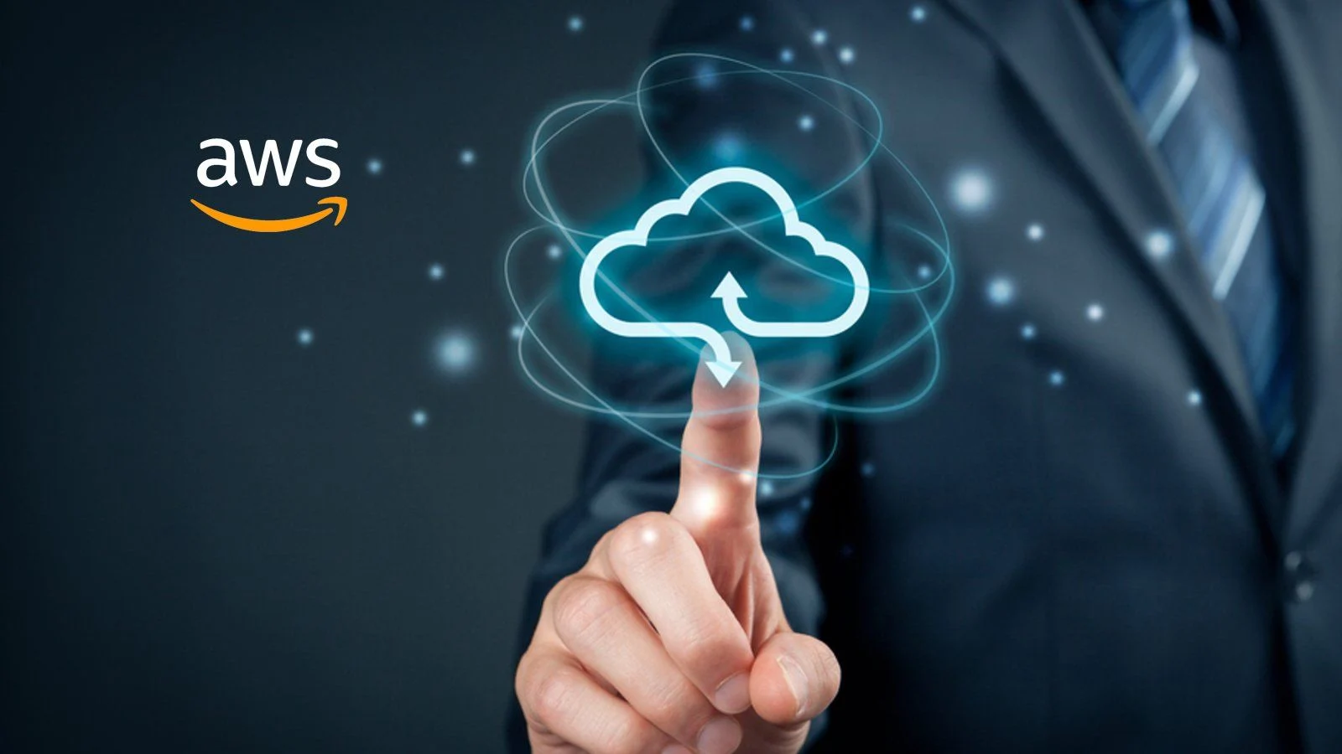
Virtual Private Cloud(VPC)

Slide 2
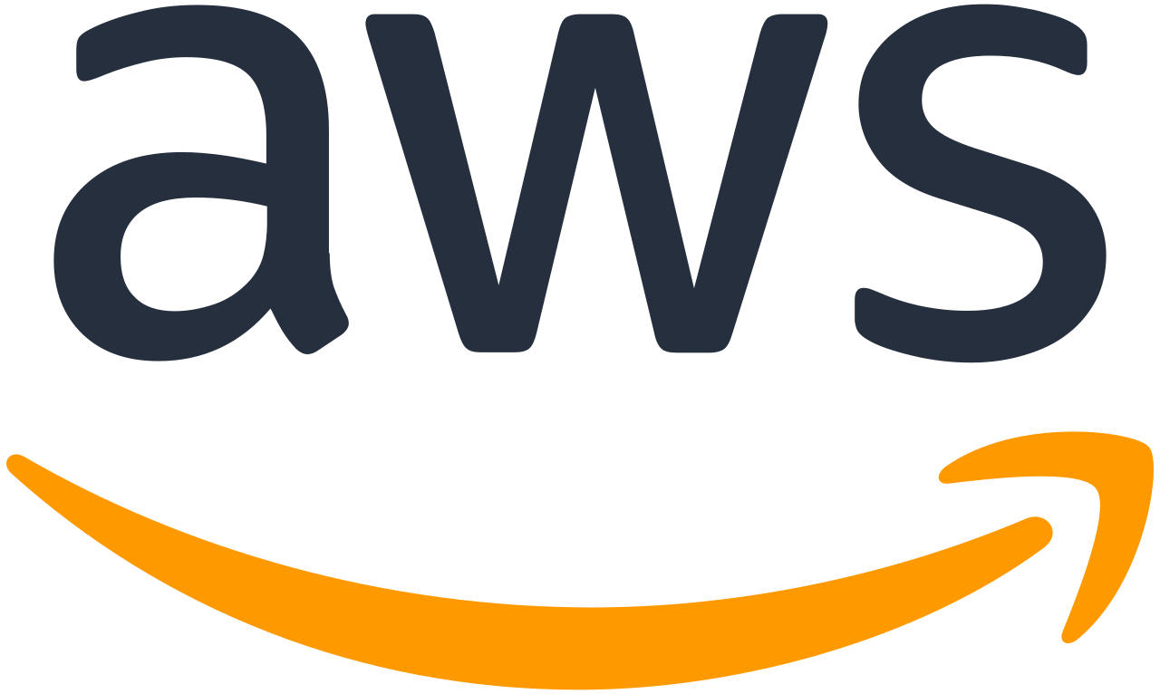
Overview
VPC & Subnets
Internet Gateway & NAT Gateway
Network ACL( NACL ) & Security Groups
VPC Flow Logs
VPC Peering
VPC Endpoints
Site-to-Site & Direct Connection( DX )

Slide 3
VPC & Subnets
Virtual Private Cloud(VPC) enables you to launch Amazon Web Services resources into a virtual network you've defined.
Subnets are regional resources and have IP address ranges associated with them.
A Public Subnet is a subnet that is accessible from the internet.
A Private Subnet that is not accessible from the internet.
To define access to the internet and between subnets, we use Route Tables.

Slide 4
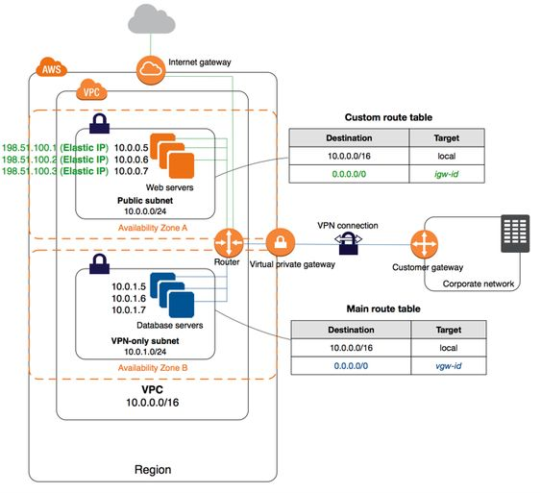
VPC Diagram

Slide 5
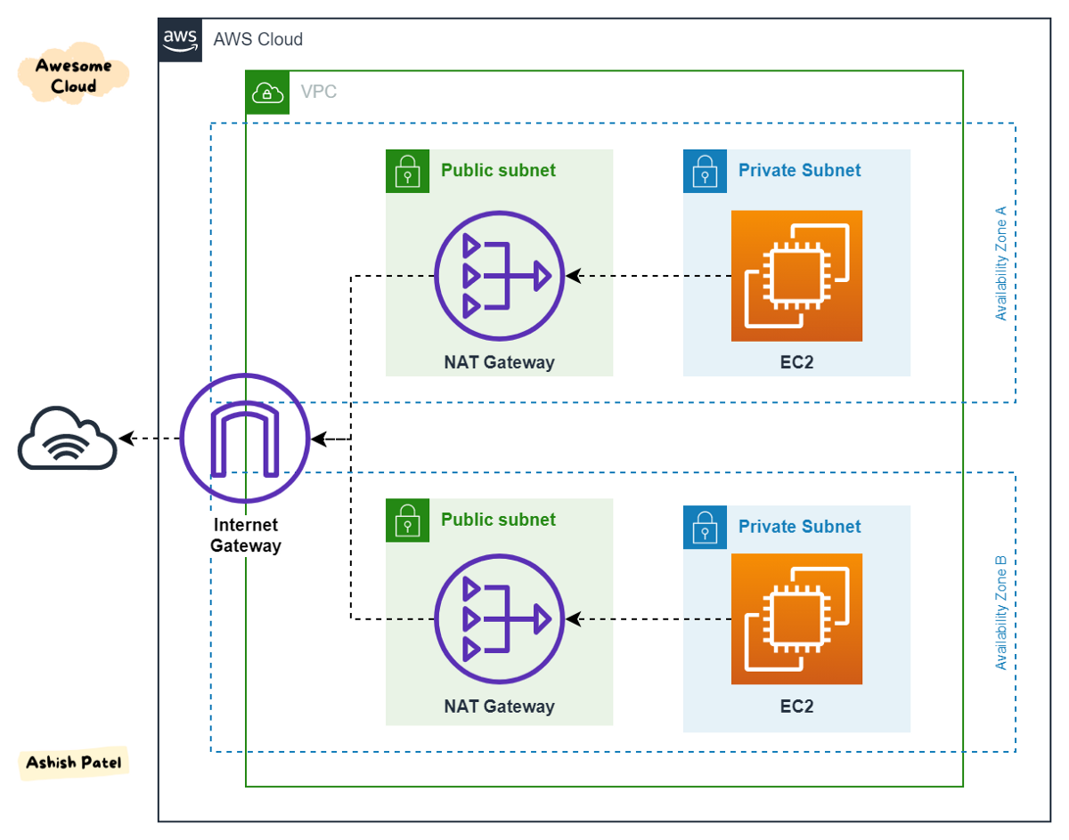
Internet Gateway & NAT Gateways
Internet Gateways helps our VPC instances connect with the internet
Public Subnets have a route to the internet gateway.
NAT Gateways(AWS- managed) & NAT Instances( self-managed) allow your instances in your Private Subnets to access the internet while remaining private

Slide 6
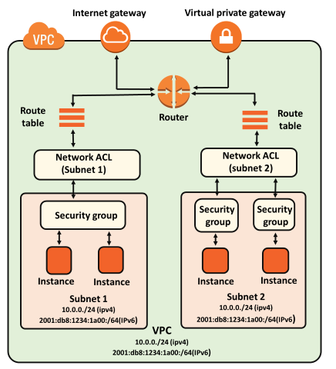
Network ACL & Security Groups
NACL( Network ACL )
A firewall which controls traffic from and to subnet
Can have ALLOW and DENY rules
Are attached at the Subnet level
Rules only include IP addresses
Security Groups
A firewall that controls traffic to and from an ENI / an EC2 instance
Can have only ALLOW rules
Rules include IP addresses and other security groups

Slide 7
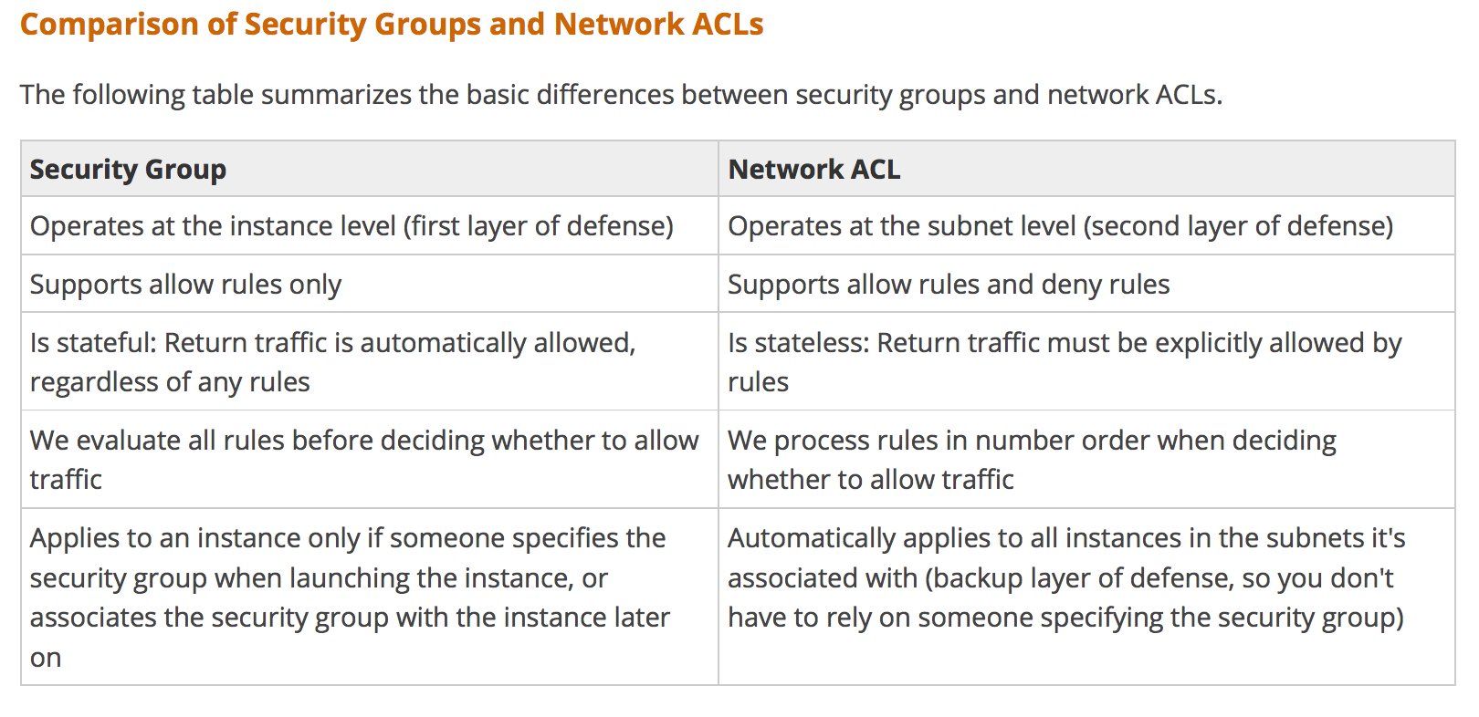

Slide 8
VPC Flow Logs
Capture information about IP traffic going into you interfaces:
VPC Flow Logs
Subnet Flow Logs
Elastic Network Interfaces Flow Logs
Helps to monitor & troubleshoot connectivity issues. Ex:
Subnet to internet
Subnet to subnet
Internet to subnet
Captures network info from AWS managed interfaces too: ELB, Elasticache etc…
VPC flow logs data can go to S3 / CloudWatch Logs

Slide 9
VPC Peering
Connect two VPC privately using AWS’ network
Make them behave as if they were in the same network
Must not have overlapping IP address range
VPC peering connection is not transitive

Slide 10
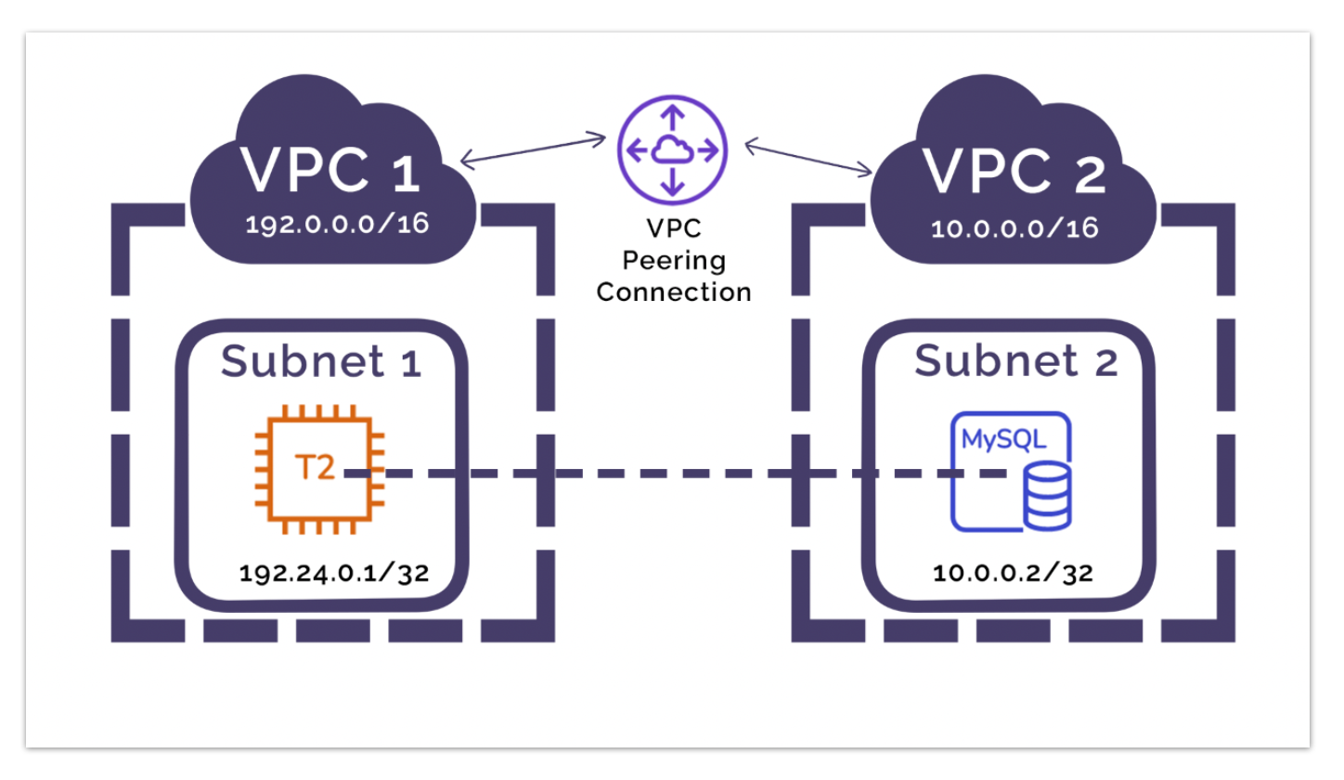

Slide 11
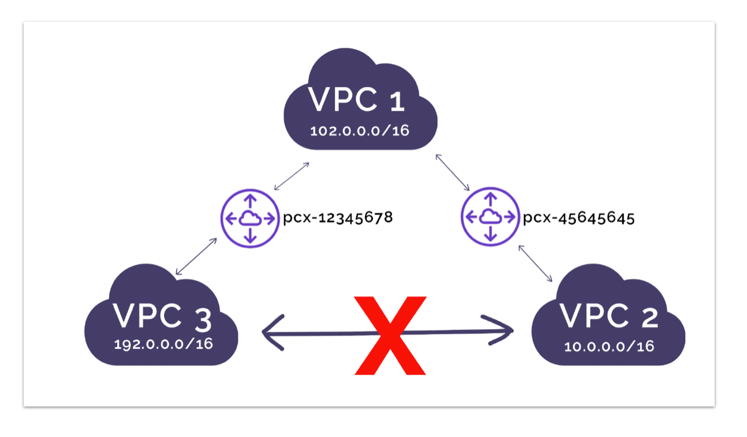

Slide 12
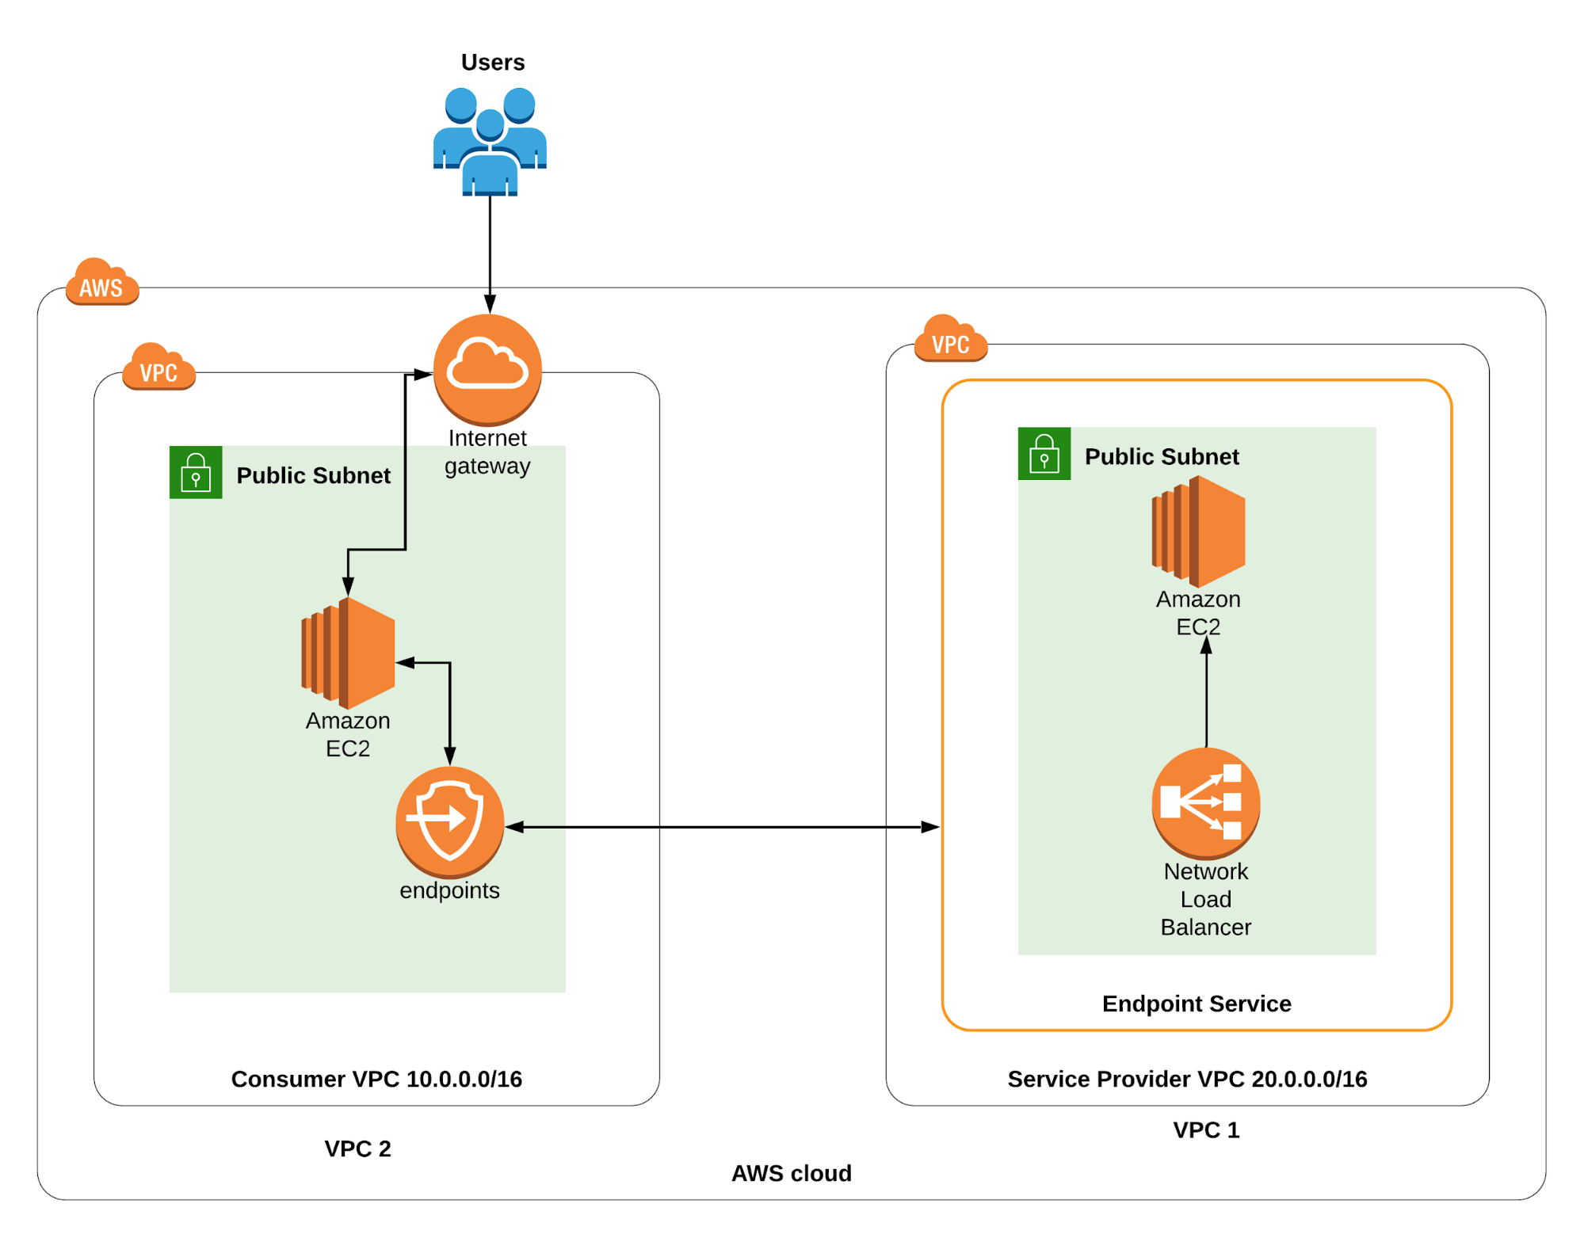
VPC Endpoints
Endpoints allow you to connect to AWS Services using a private network instead of public WWW network
This gives you enhanced security and lower latency to access AWS services
VPC Endpoint Gateway : S3 & DynamoDB
VPC Endpoint Interface: the rest
Only used within your VPC

Slide 13
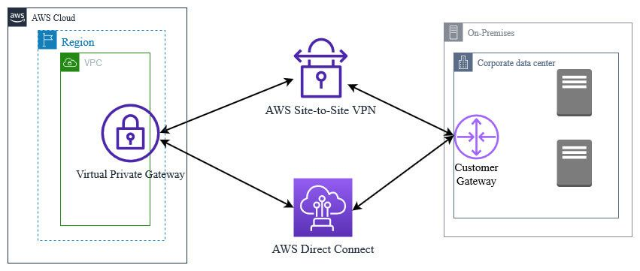
Site to Site VPN & Direct Connect
Site to site VPN
Connect an on-premises VPN to AWS
The Connection is automatically encrypted
Goes over the public internet
Direct Connect( DX )
Establish a physical connection between on-premises and AWS
The connection is private, secure and fast
Goes over a private network
Takes at least a month to establish
Site to site VPN and Direct connect cannot access VPC endpoints

Slide 14


